Slide 1
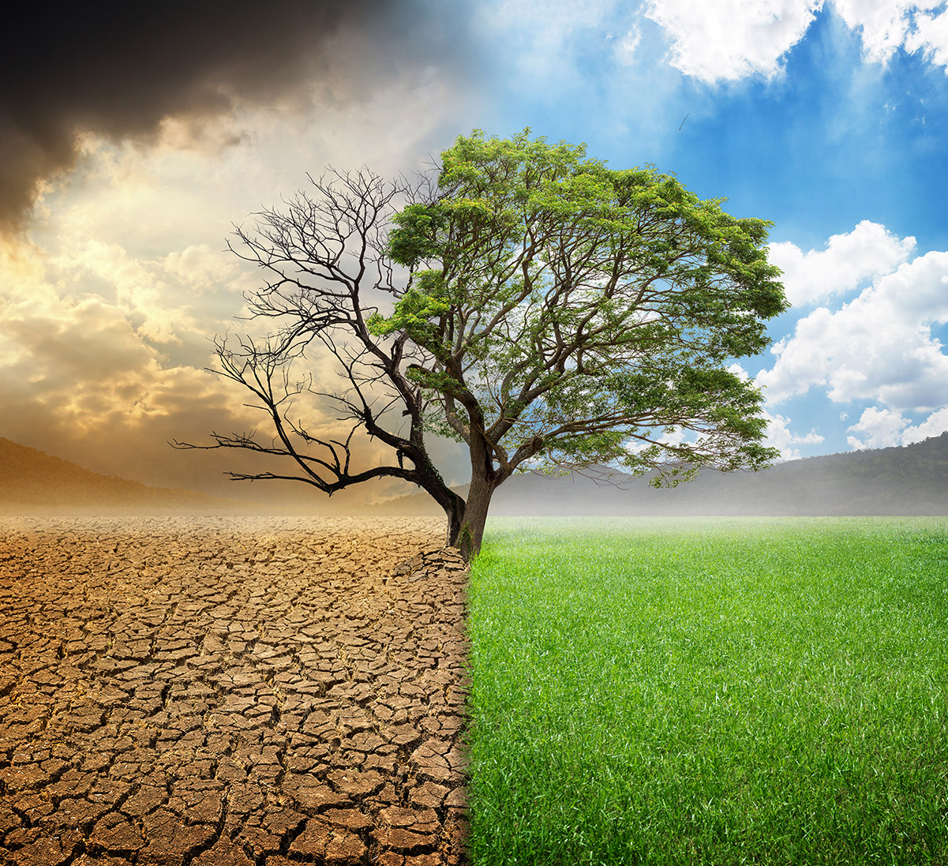
CLIMATE CHANGE PREDICTION THROUGH TEMPERATURE CHANGE BY ML

Slide 2

Abstract
Requirements
System Implementation
Input & output design
Conclusion & Reference
Introduction
CONTENTS:

Slide 3
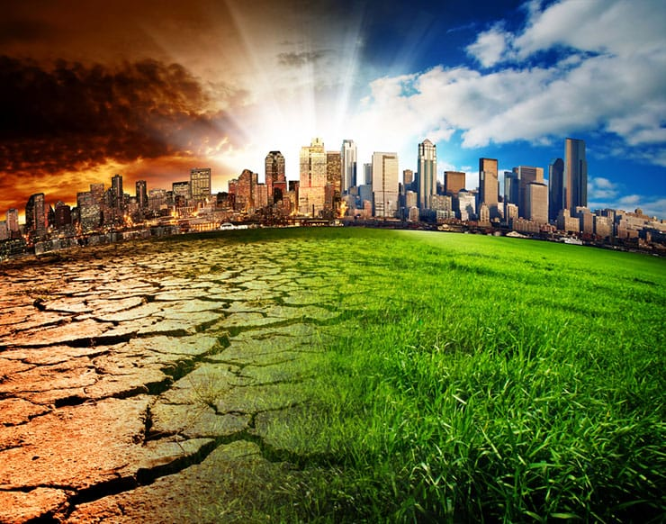
ABSTRACT
Machine Learning Project
Historical Temperature Data
Climate Change Through Temperature Change
Feature engineering,Model selection,Validation Techniques

Slide 4

INTRODUCTION
Challenge of predicting future climate changes
Historical Temperature data-smart computer programs
Mission-to enhance our ability to know the impacts of climate change
Hi-tech Weather Forecaster for the planet

Slide 5
REQUIREMENTS
SOFTWARE REQUIREMENTS
Operating System : Windows 10/11 or MAC OS.
HARDWARE REQUIREMENTS
Processor : Intel core i3 and above
Platform : Google colab, PyCharm IDE
Programming Language : Python, SQL
Hard Disk : 1 TB or above.
RAM : 4 GB or above.

Slide 6
SYSTEM IMPLEMENTATION
PSEUDO CODE:
Step 1: Import the required packages.
Step 2: Download the dataset and link it to the google colab.
Step 3: Read the dataset and perform operations on data.
Step 4: Data cleaning.
Step 5: Data Preprocessing.
Step 6: Saving the cleaned campous data set after performing operations on data.
Step 7: Start training the Machine learning Model.
Step 8: Split features and target as x and y respectively.
Step 9: Split the new data into 70% of Training data and 30% of Testing data.
Step 10: Train the model with Training data and Testing data.
Step 11: Implementing one hot encoder and column transformer to model.
Step 12: Applying Logistic Regression to the model.
Step 13: Fit the Logistic Regression Model.
Step 14: If accuracy is good use the model for prediction else fit the model again, using other random states.
Step 15: Dump the Logistic Regression model into our files using pickle .
Step 16: Open Pycharm and extract the cleaned placement.csv and Logistic Regression Model.pkl files into our project.
Step 17: Reading the model and dataset, make the prediction using python and flask from webpage.

Slide 7
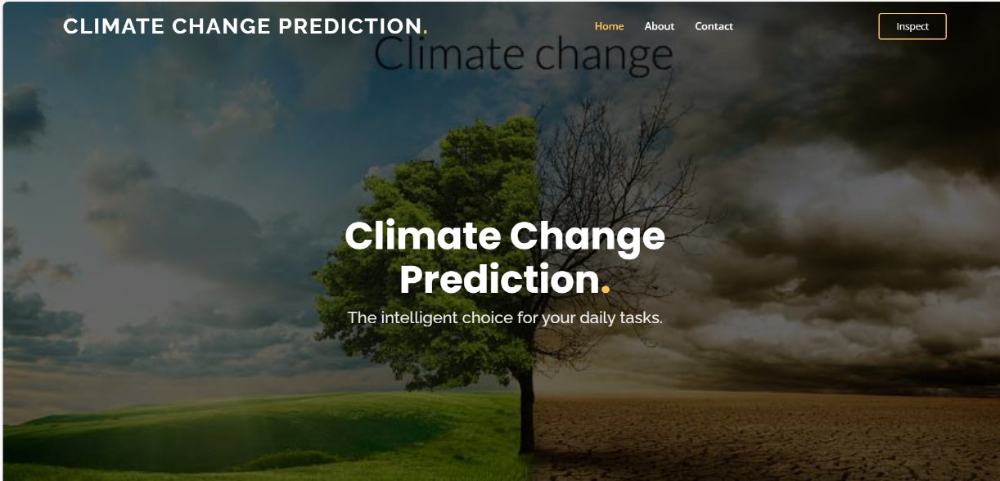
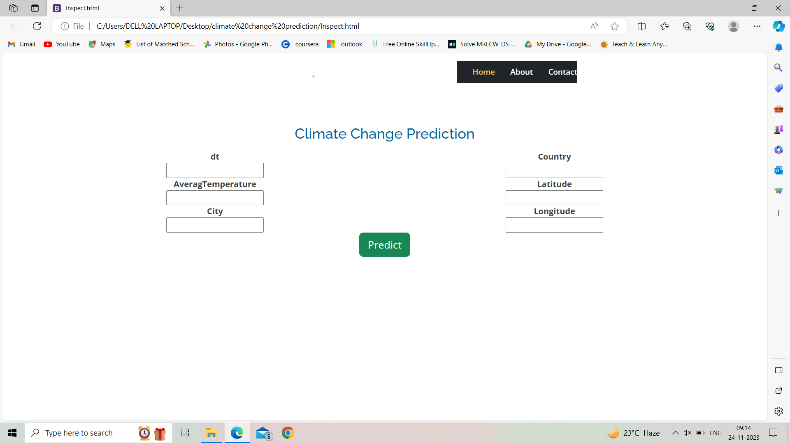
INPUT DESIGN

Slide 8
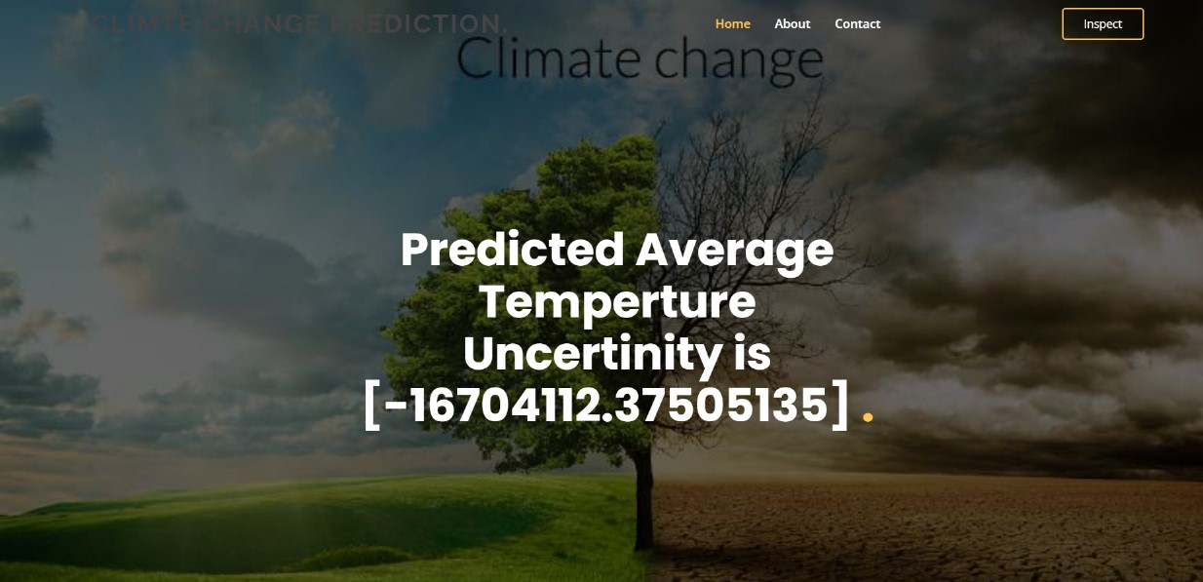
OUTPUT DESIGN

Slide 9

CONCLUSION:
Predicting climate change is a challenging but crucial task that requires using a lot of data, working together with experts from different fields, and choosing the right methods to get accurate and meaningful results.
REFERENCES:
https://www.kaggle.com/datasets/berkeleyearth/climate-change-earth-surface-temperature-data

Slide 10
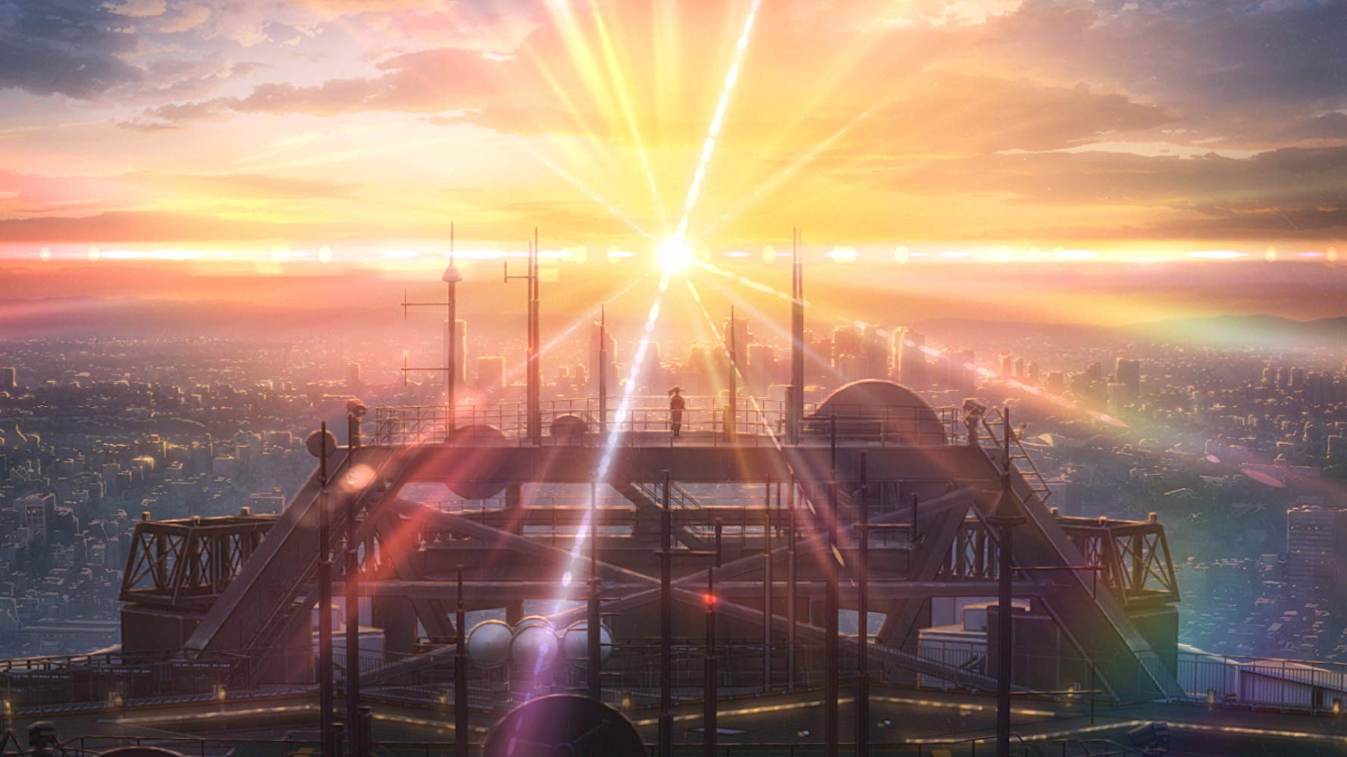
THANK YOU

